Slide 1

Title : 🗨 AI Buddy Chatbot — An intelligent
conversational assistant
Course : Full Stack Development (FSD)
Team Members:
Mentor: Dr.Lalitha Mam
Technology Stack: React.js, Node.js,
Express.js, HTML, CSS, SerpAPI
Tejaswini - 23251A05E0
Udaya Sri - 23251A05H3
Swapna - 23251A05K5

Slide 2

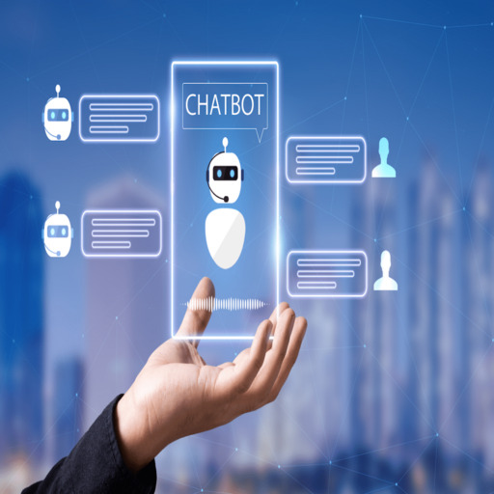
Introduction About the Project
AI Buddy is a web-based chatbot application designed to provide users with
intelligent, conversational assistance.
It integrates with SerpAPI to deliver real-time search results, ensuring accurate
and up-to-date responses.
The system includes a secure user authentication module with Sign Up, Sign In,
and Logout features.
Developed using a modern full stack:
Frontend: React.js (interactive UI)
Backend: Node.js with Express.js (API handling & server logic)
Focused on creating a user-friendly, responsive, and reliable
chatbot experience.

Slide 3
Problem Statement
Create a Chat module/Interface using HTML CSS and JavaScript. The chat interface primarily
consists of two segments: the message header and the chat box.
Message-Header- The message header resides at the top of the chat box. It includes the user’s
name, avatar or profile image, and the user’s last seen. Last seen is the last time the user was
active.
The Chat-Box- The chat box consists of the message page and the message bottom sections.
Message page-The message page consists of incoming and outgoing messages, as well as the
avatars of the senders. It also displays the time at which each message is sent.
The Message-Bottom-This section contains an input field where the user can type in the messages
and a send button to send them.

Slide 4
Project Scope
The Chatbot:
⚡ Instant, human‑like responses for smooth user interaction
🔐 User authentication system (Sign Up, Sign In, Logout)
👤 Avatars & timestamps for a personalized chat experience
📜 Scrollable chat history to maintain conversation context
🚀 Future extensibility with OpenAI API or Dialogflow integration

Slide 5
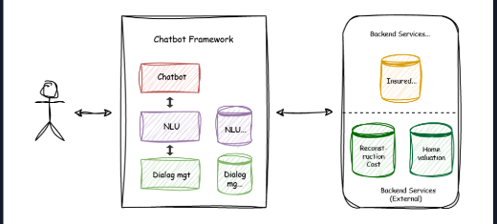
System Architecture :

Slide 6
REACT CONCEPTS USED
Concept | Description | Example in Project
Components | Divided the UI into reusable parts like ChatHeader, ChatBox, Message | <ChatBox />
Props | Passed data between parent and child components | Avatar, Message Text
State | Used to manage chat messages dynamically | useState([])
useEffect | Triggered actions like fetching data on load | Used in API call logic
Event Handling | For send button and input field | onClick, onKeyPress
Routing | Navigation between login, signup, chat | React Router (optional)
Conditional Rendering | To show user vs bot messages differently | sender === 'bot' ? ... : ...

Slide 7
BACKEND
Responsibilities:
Handles all HTTP requests.
Manages Sign Up / Sign In / Chat routes.
Uses body-parser for JSON handling.
Communicates with SerpAPI for AI-like answers

Slide 8

FRONTEND
Key Components:
Chat Page (chat.html): Displays messages, avatars, timestamps, logout.
Sign Up / Sign In Pages: Authentication handled via local storage.
CSS (style2.css): Responsive layout with scrollable chat window.

Slide 9
FEATURES IMPLEMENTED
✅ Sign Up / Sign In with Validation
✅ Chat Interface with Avatars
✅ Dynamic Timestamps
✅ Scrollable Chat Window
✅ Logout Functionality
✅ Real-time AI Responses (SerpAPI Integration)
✅ Frontend + Backend Connection

Slide 10
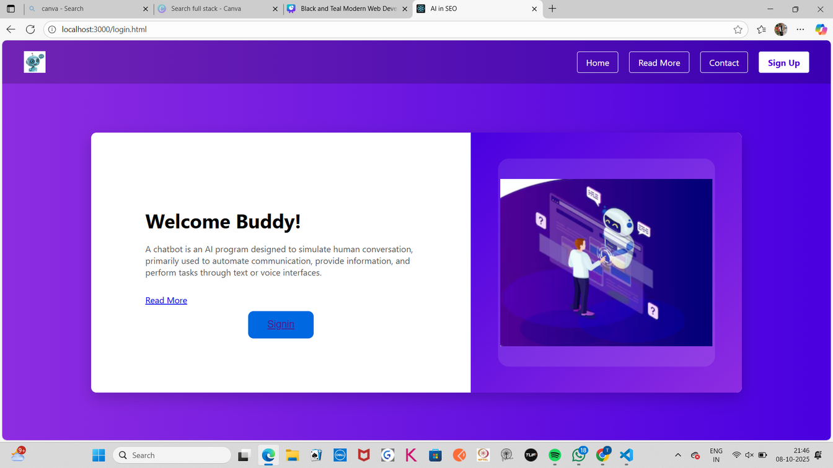
OUTPUT SCREENSHOTS

Slide 11
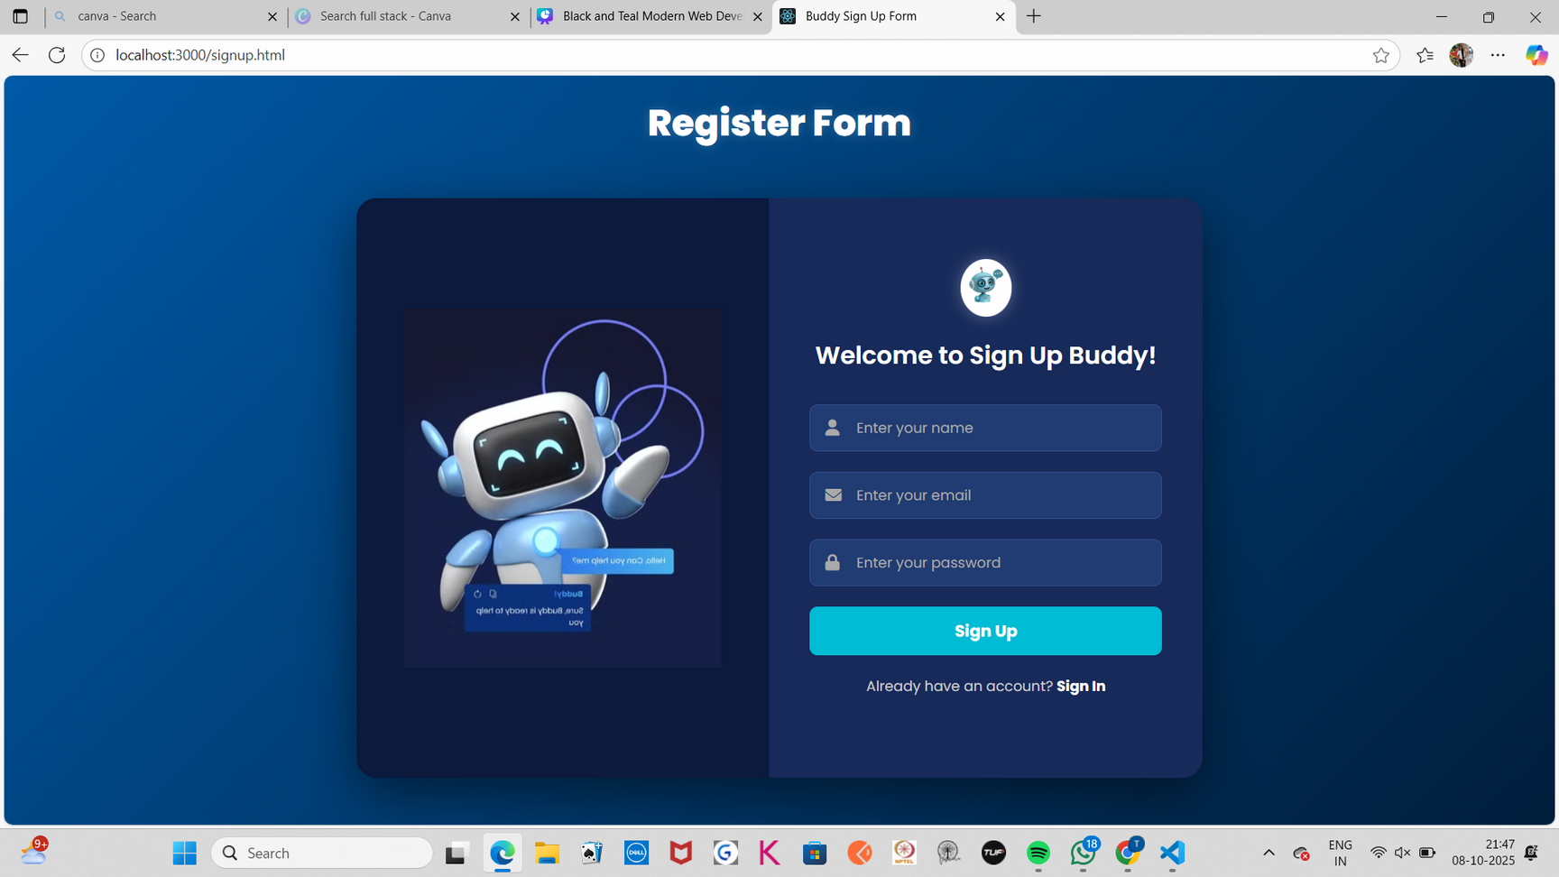

Slide 12
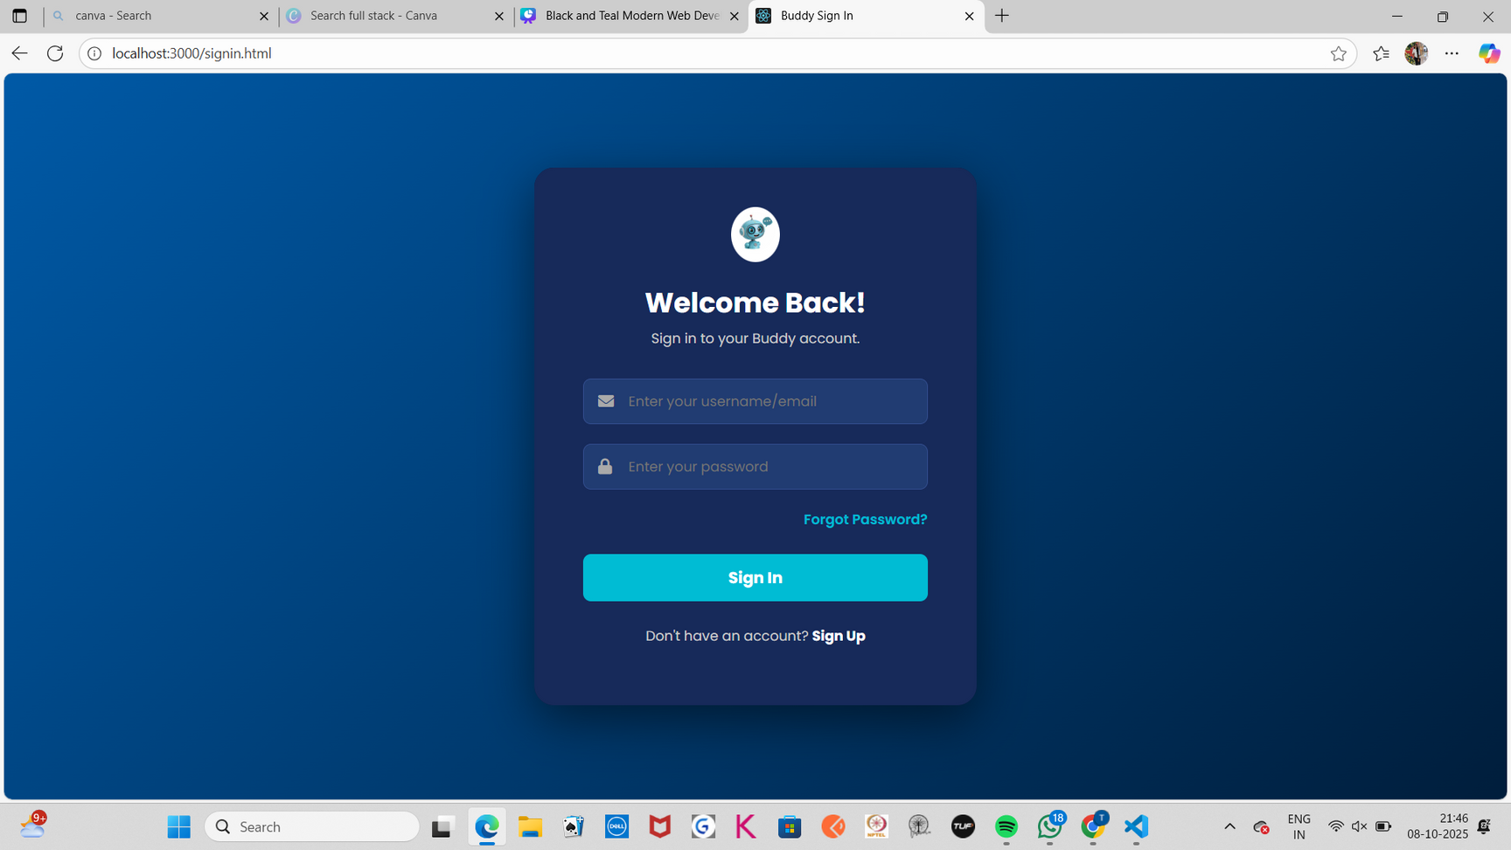

Slide 13
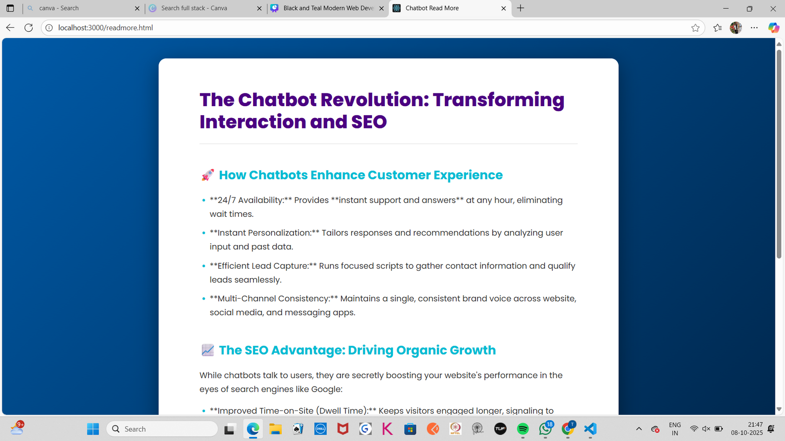

Slide 14
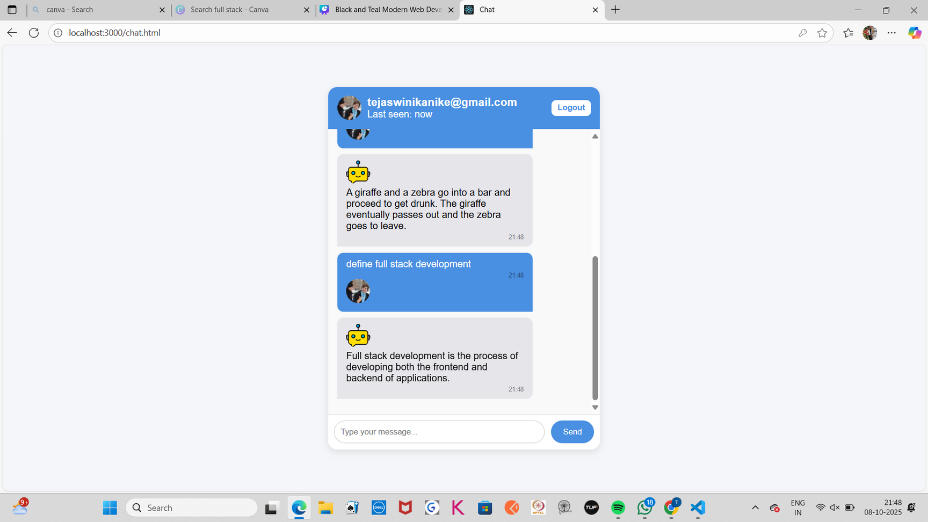

Slide 15

Learning Outcomes
Creating responsive UI HTML, CSS, JS.
Building APIs using Express.js.
Managing frontend-backend communication using Fetch and Axios.
Implementing user authentication using Local Storage.
Integrating third-party APIs (SerpAPI).
Understanding state management and hooks in React.
Using Git & GitHub for version control and collaboration.
Improved team communication and debugging skills.

Slide 16
Challenges Faced
Challenge
Challenge
Solution
Integrating API calls
Used Axios + Express middleware
Local storage data validation
Added client-side validation
UI responsiveness
Used CSS flexbox layout
Served static files via express.static("public")
“Cannot GET /” issue

Slide 17
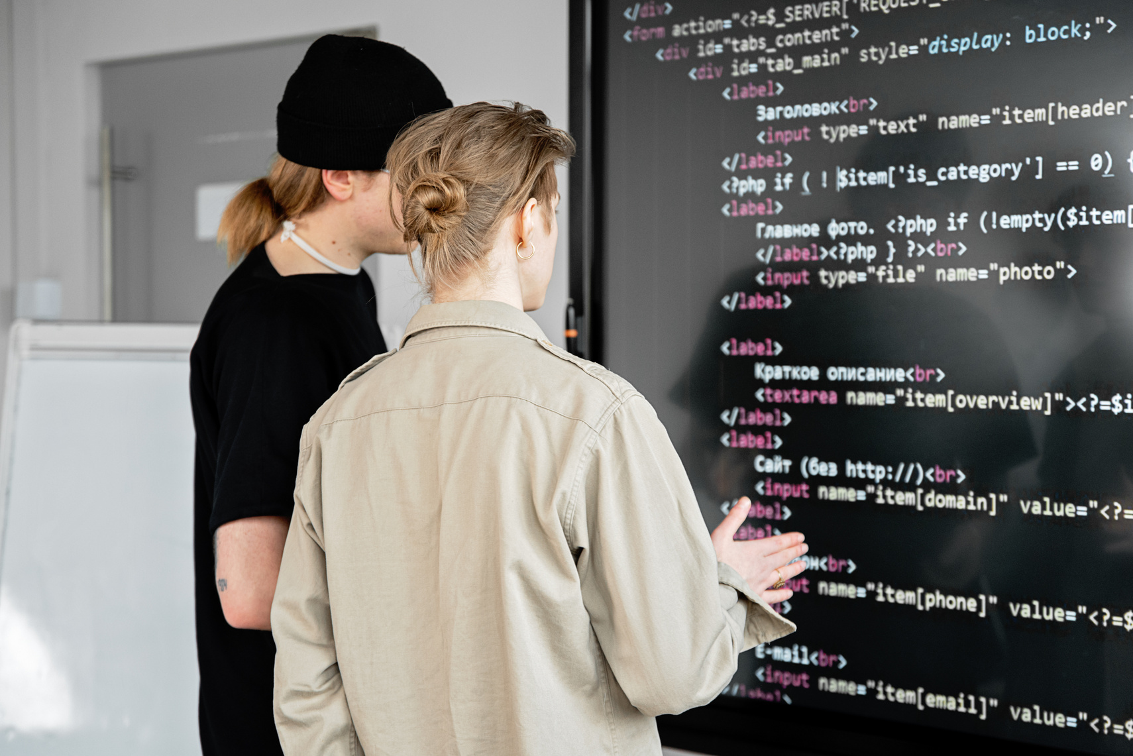

Future Enhancements
Add OpenAI GPT API for advanced conversation.
Store messages and user data in MongoDB.
Add speech-to-text and voice replies.
Deploy on Render, Netlify, or Vercel.
Add Dark/Light Mode for UI.
Arowwai Industries

Slide 18

Conclusion
The AI Buddy Chatbot demonstrates end-to-end full-stack development.
It integrates React (frontend), Node.js (backend), and API communication effectively.
We successfully achieved all key goals: interactive UI, API integration, and authentication.

Slide 19
THANK YOU

